Slide 1

Designing of IoT Solutions
IoT Physical Devices & Endpoints
Charanraj B R
Department of Computer Science Engineering

Slide 2

Designing of Iot solutions
Arduino
Charanraj B R
Department of Computer Science Engineering

Slide 3
Designing of IoT Solution
Outline of Presentation
Arduino

Slide 4
Designing of IoT Solution
Arduino- What is an Arduino?
Arduino has been the brain of projects
A worldwide community.
Sending a set of instructions to the microcontroller on the board.
Uses SPI, UART and I2C protocols to transfer data at high speeds to compatible devices.

Slide 5
Designing of IoT Solution
Arduino- Advantages
Inexpensive - Inexpensive compared to other microcontroller platforms. less than $50.
Cross-platform - Windows, Macintosh OSX, and Linux operating systems.
Simple, clear programming environment Easy-to-use for beginners
Open source and extensible software - open source tools, available for extension by experienced programmers.

Slide 6
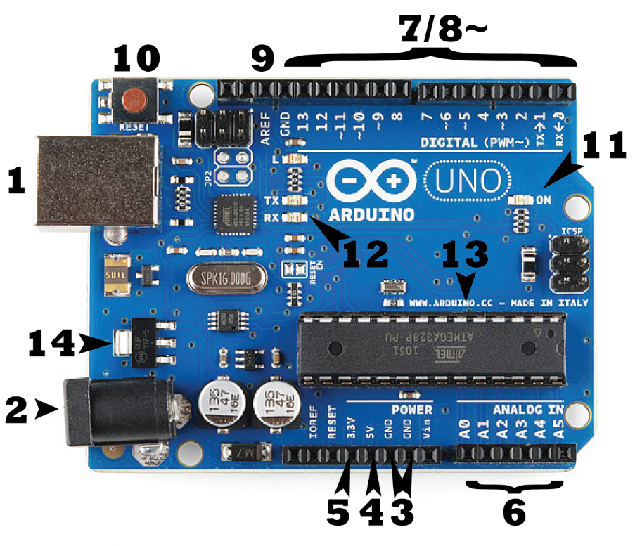
Designing of IoT Solution
Arduino- Hardware

Slide 7
Designing of IoT Solution
Arduino- Hardware
The ATmega328 microcontroller is the MCU. ATmega328 is an MCU from the AVR family; it is an 8-bit device,
ATmega328 has three :
Flash memory
SRAM memory
EEPROM memory

Slide 8
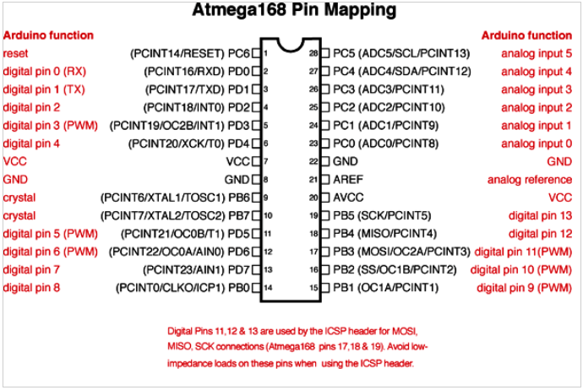
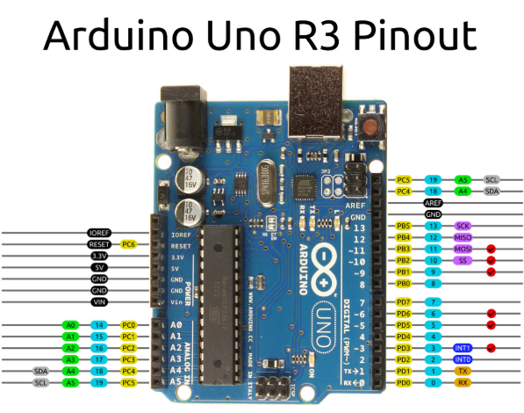
Designing of IoT Solution
Arduino- Hardware

Slide 9
Designing of IoT Solution
Arduino- Software
Arduino Software (IDE) - It connects to the Arduino and Hardware to upload programs
Sketches.
file extension .ino.
Cutting/pasting and for searching/replacing text.

Slide 10
Designing of IoT Solution
Arduino- Software
Feedback while saving and exporting and displays errors.
Complete error messages and other information.
Displays the configured board and serial port.
Verify and upload programs, create, open, and save sketches, and open the serial monitor.
File > Sketchbook menu or from the Open button on the toolbar.
Automatically create a directory for your sketchbook.

Slide 11
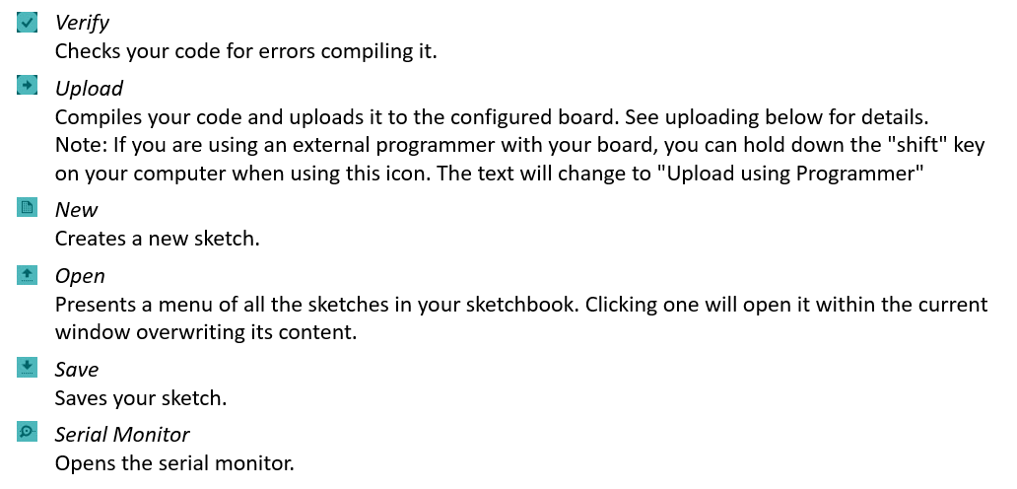
Designing of IoT Solution
Arduino- Software

Slide 12
Designing of IoT Solution
Different types of Arduino Boards
1.Arduino UNO (R3)
2.Lilypad Arduino
3.RedBoard
4.Arduino Mega (R3)
5.Arduino Leonardo

Slide 13
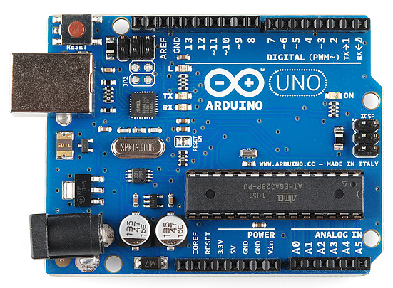
Designing of IoT Solution
Different types of Arduino Boards
1.Arduino UNO (R3)

Slide 14
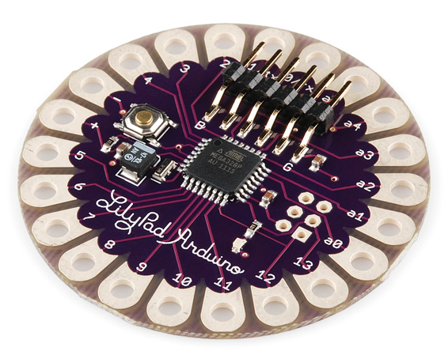
Designing of IoT Solution
Different types of Arduino Boards
2.Lilypad Arduino

Slide 15
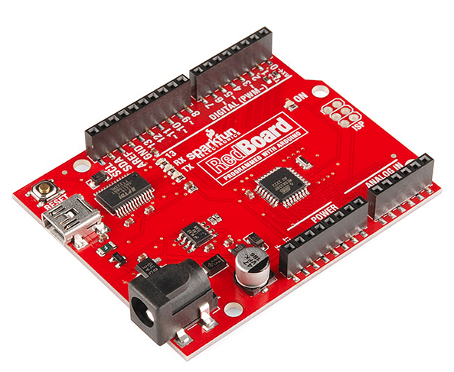
Designing of IoT Solution
Different types of Arduino Boards
3.RedBoard

Slide 16
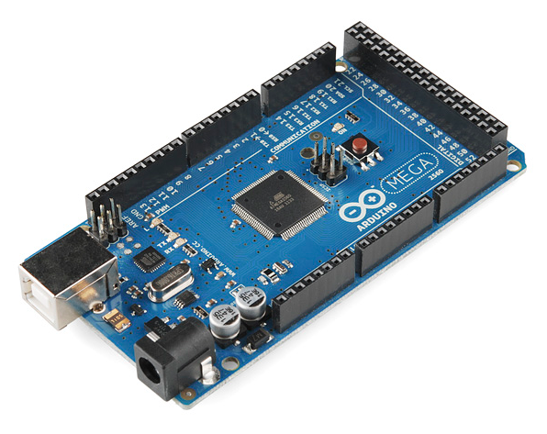
Designing of IoT Solution
Different types of Arduino Boards
4.Arduino Mega (R3)

Slide 17
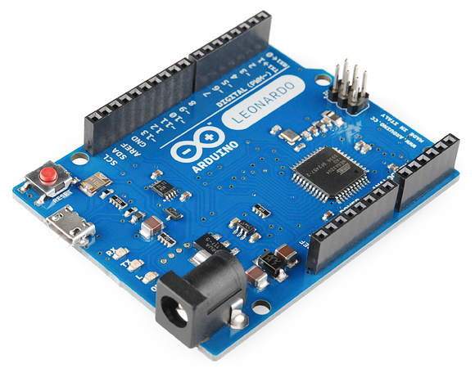
Designing of IoT Solution
Different types of Arduino Boards
5.Arduino Leonardo
https://www.sparkfun.com/standard_arduino_comparison_guide

Slide 18
THANK YOU
Charanraj B R
Department of Computer Science Engineering
charanarajbr@pes.edu
+91 80 6666 3333 Extn 721

